Slide 1

8th Grade Math
Unit 12, Lesson 5 Factoring Common Monomials Factors Volume 2, pg. 236

Slide 2


Benchmark
MA.8.AR.1.3
Rewrite the sum of two algebraic expressions having a common monomial factor as a common factor multiplied by the sum of two algebraic expressions.
volume 2, pg. 236

Slide 3
Integrated Mathematical Thinking and Reasoning Standards
MA.K12.MTR.1.1 Actively participate in effortful learning both individually and collectively.
MA.K12.MTR.2.1 Demonstrate understanding by representing problems in multiple ways.
MA.K12.MTR.4.1 Engage in discussions that reflect on the mathematical thinking of self and others.
volume 2, pg. 236

Slide 4

Learning Target
I can rewrite an algebraic expression with two terms that have a common monomial factor using the distributive property.
volume 2, pg. 236

Slide 5

Warm-Up
volume 2, pg. 237

Slide 6
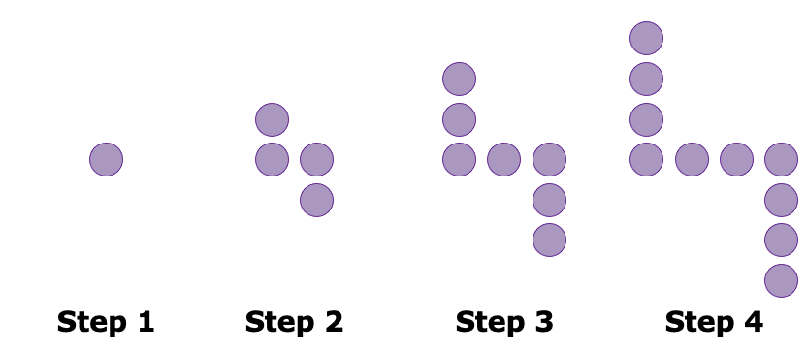
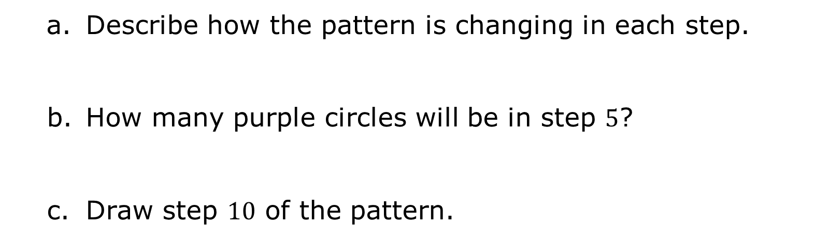
12.5.1 Warm-Up: Visual Patterns
1. The first four steps in a pattern are shown.
Describe how the pattern is changing in each step.
How many purple circles will be in step $5$?
Draw step $10$ of the pattern.
volume 2, pg. 237

Slide 7

Exploration
volume 2, pg. 237

Slide 8

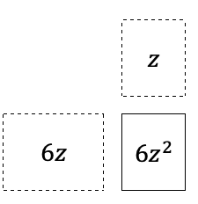
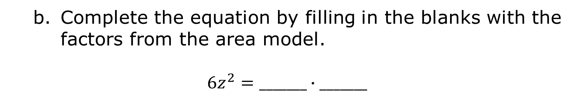
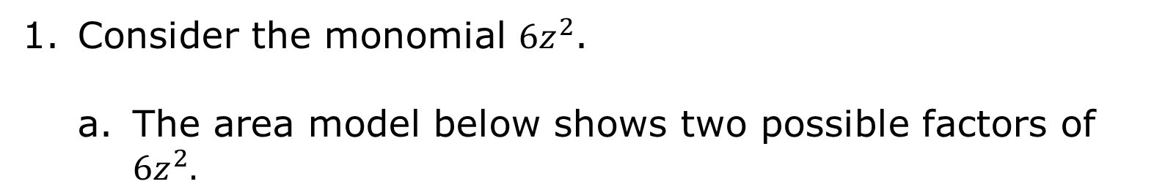
12.5.2 Exploration: Finding Common Factors of Monomials
Consider the monomial ${6z}^{2}$.
The area model below shows two possible factors of ${6z}^{2}.$
Complete the equation by filling in the blanks with the factors from the area model.
$${6z}^{2}=_______∙_______$$
volume 2, pg. 237

Slide 9
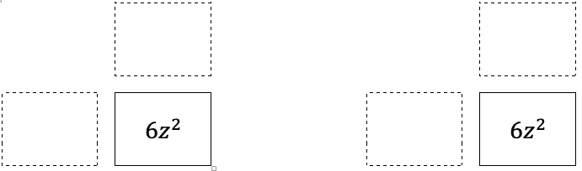


Work with your partner to identify two other possible pairs of factors for the monomial ${6z}^{2}.$
$${6z}^{2}=_______∙_______$$
$${6z}^{2}=_______∙_______$$
Explain what strategy you used to identify factor pairs that multiply to ${6z}^{2}.$
volume 2, pg. 237

Slide 10
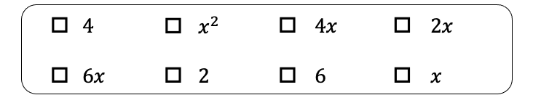

2. Consider the expression ${4x}^{2}+12x$.
Work with your partner to determine which of the terms shown are common factors of ${4x}^{2}$ and $12x$.
Explain how you made your choices.
volume 2, pg. 238

Slide 11
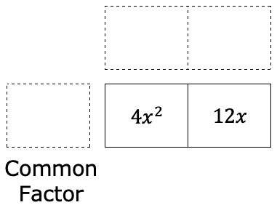


Choose one of the common factors from Part A. Work with your partner to complete the area model using the common factor.
Rewrite the expression ${4x}^{2}+12x$ in factored form using the factors determined in Part C.
$$_______\left(_______+ _______\right)$$
volume 2, pg. 238

Slide 12
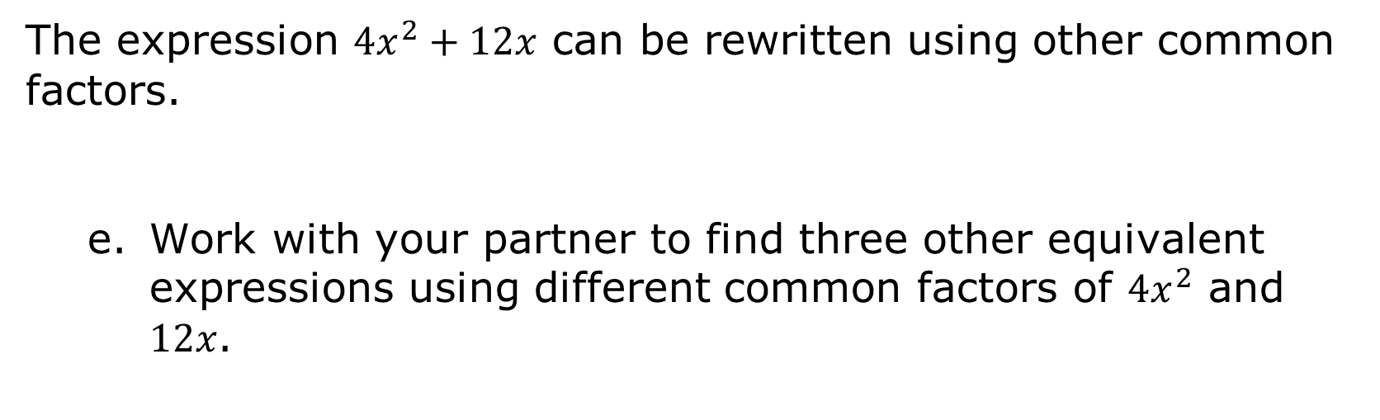



The expression ${4x}^{2}+12x$ can be rewritten using other common factors.
Work with your partner to find three other equivalent expressions using different common factors of ${4x}^{2}$ and $12x$.
$$_______\left(_______+ _______\right)$$
$$_______\left(_______+ _______\right)$$
$$_______\left(_______+ _______\right)$$
volume 2, pg. 238

Slide 13

Bring It Together
volume 2, pg. 239

Slide 14

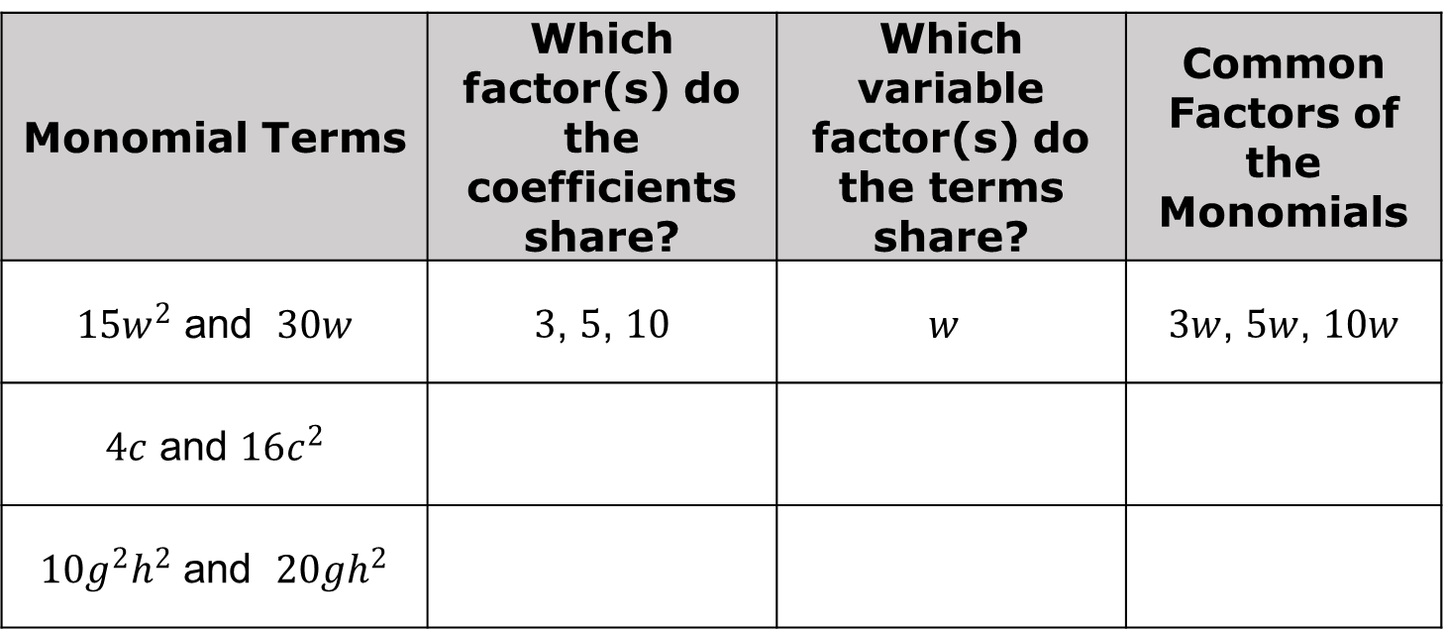
12.5.3 Bring It Together: Finding Common Factors of Monomials
Similar to whole numbers, common factors of monomials can be found by considering the factors each term shares.
Work with your partner to complete the table. The first row has been completed.
Monomial Terms | Which factor(s) do the coefficients share? | Which variable factor(s) do the terms share? | Common Factors of the Monomials
$15w^{2}$ and $30w$ | $3$, $5$, $10$ | $$w$$ | $3w$, $5w$, $10w$
$4c$ and $16c^{2}$
$10g^{2}h^{2}$ and $20gh^{2}$
volume 2, pg. 239

Slide 15
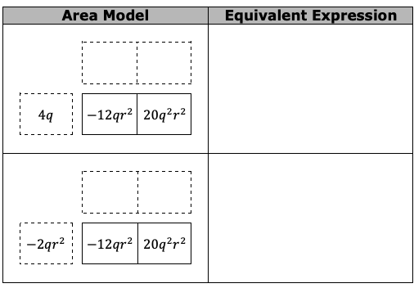
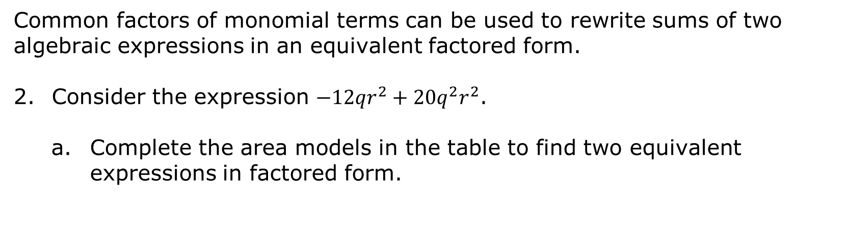
Common factors of monomial terms can be used to rewrite sums of two algebraic expressions in an equivalent factored form.
Consider the expression ${−12qr}^{2}+{20q}^{2}r^{2}$.
Complete the area models in the table to find two equivalent expressions in factored form.
volume 2, pg. 239

Slide 16
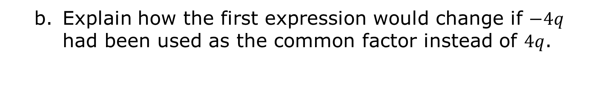
Explain how the first expression would change if $−4q$ had been used as the common factor instead of $4q$.
volume 2, pg. 239

Slide 17

Guided Practice
volume 2, pg. 240

Slide 18

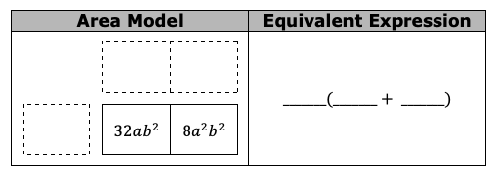
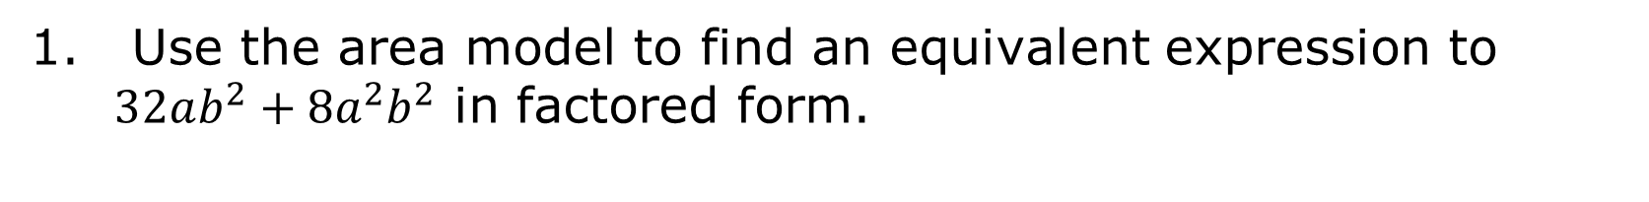
12.5.4 Guided Practice: Rewriting Expressions Using a Common Monomial Factor
1. Use the area model to find an equivalent expression to $32ab^{2}+8a^{2}b^{2}$ in factored form.
volume 2, pg. 240

Slide 19
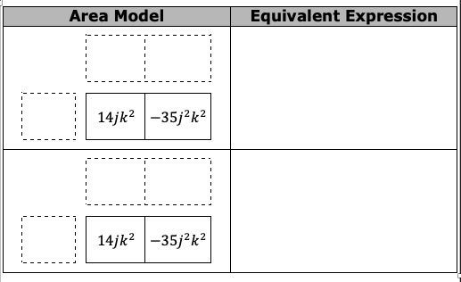
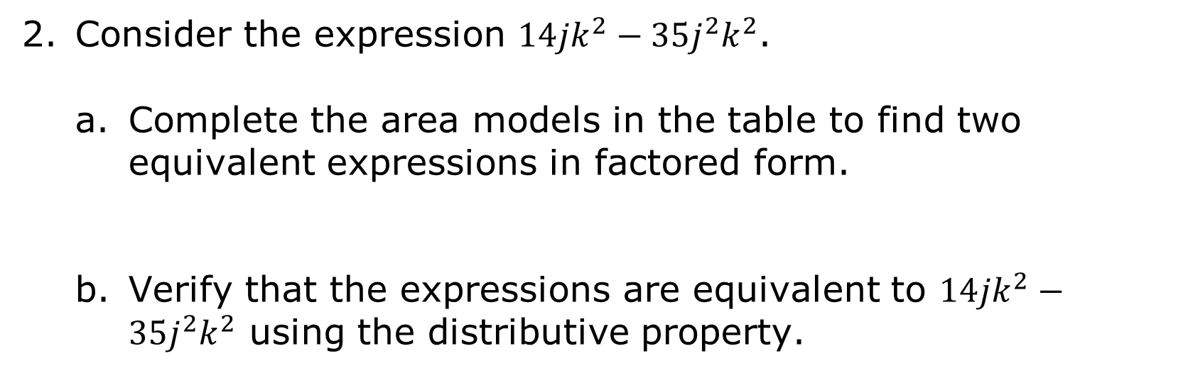
Consider the expression $14jk^{2}−35j^{2}k^{2}$.
Complete the area models in the table to find two equivalent expressions in factored form.
Verify that the expressions are equivalent to $14jk^{2}−35j^{2}k^{2}$ using the distributive property.
volume 2, pg. 240

Slide 20

Collaboration
volume 2, pg. 240

Slide 21

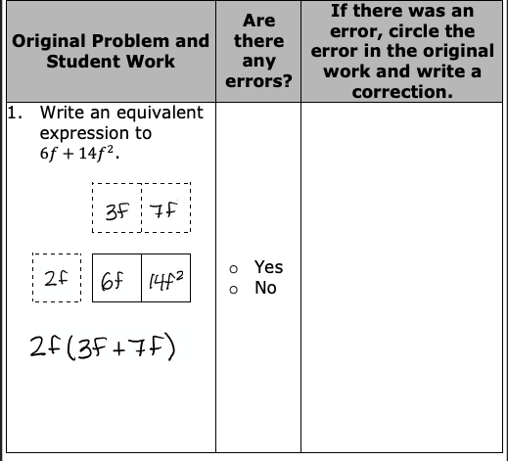
12.5.5 Collaboration: Error Analysis
One student’s work rewriting sums of algebraic expressions using common factors is shown in the table. Work with your partner to analyze the student's work and complete the table.
volume 2, pg. 240

Slide 22
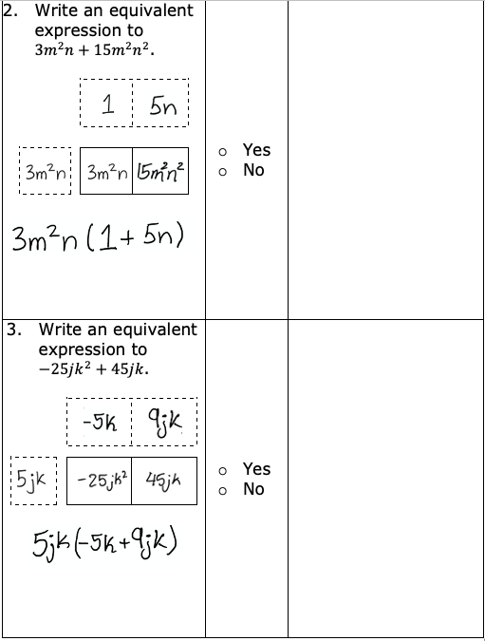
volume 2, pg. 241

Slide 23

Wrap-Up
volume 2, pg. 241

Slide 24
12.5.6 Wrap-Up: Growth Mindset
Complete each statement based on today’s lesson.
Today I am still unsure about …
I will try to build my confidence by …
volume 2, pg. 241

